Slide 1


EP
EP
EP
EP
EP

Slide 2

EP
| Epically Powerful

Slide 3
EP
Epically Powerful
An open-source code base and mechatronics platform for robotic systems

Slide 4
ep

Slide 5

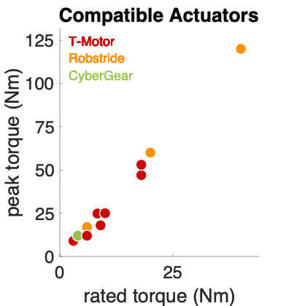

Slide 6


Slide 7
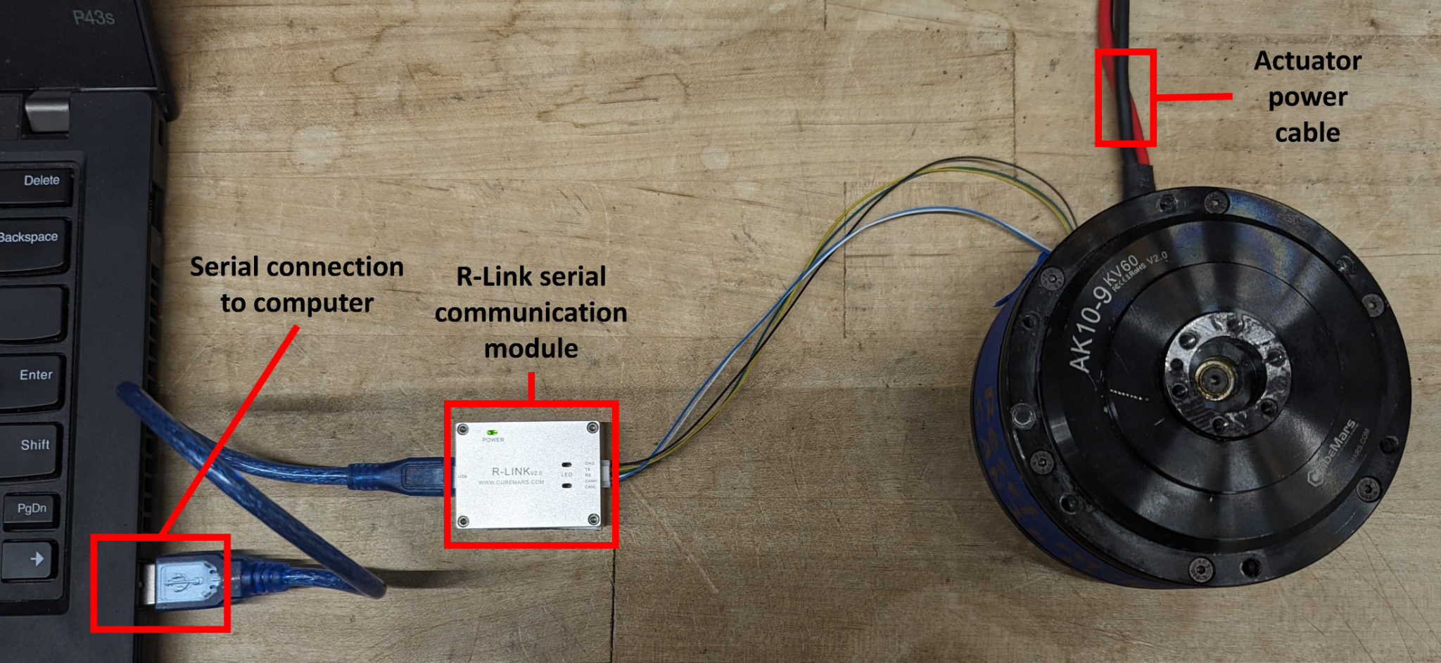

Slide 8
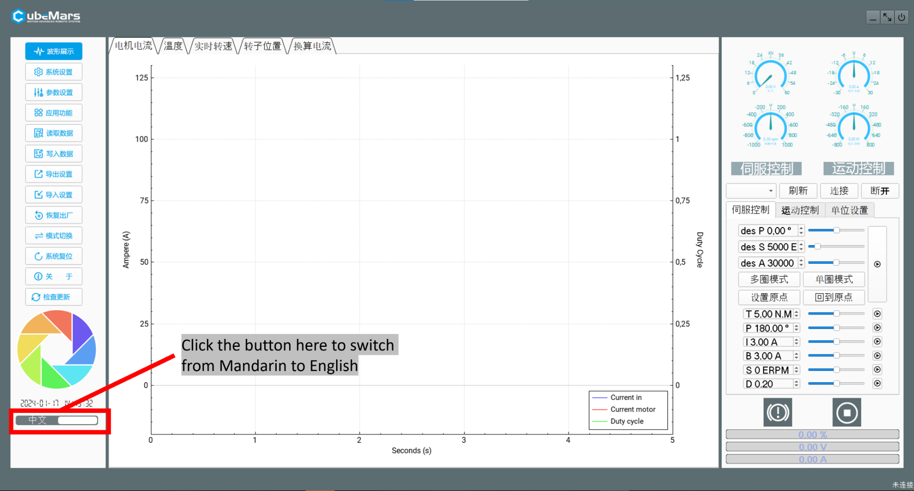

Slide 9
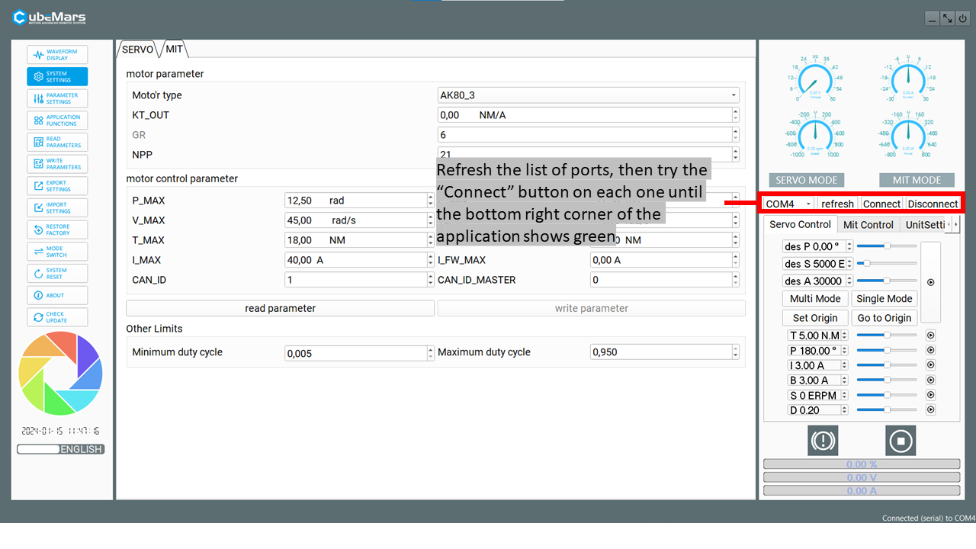

Slide 10
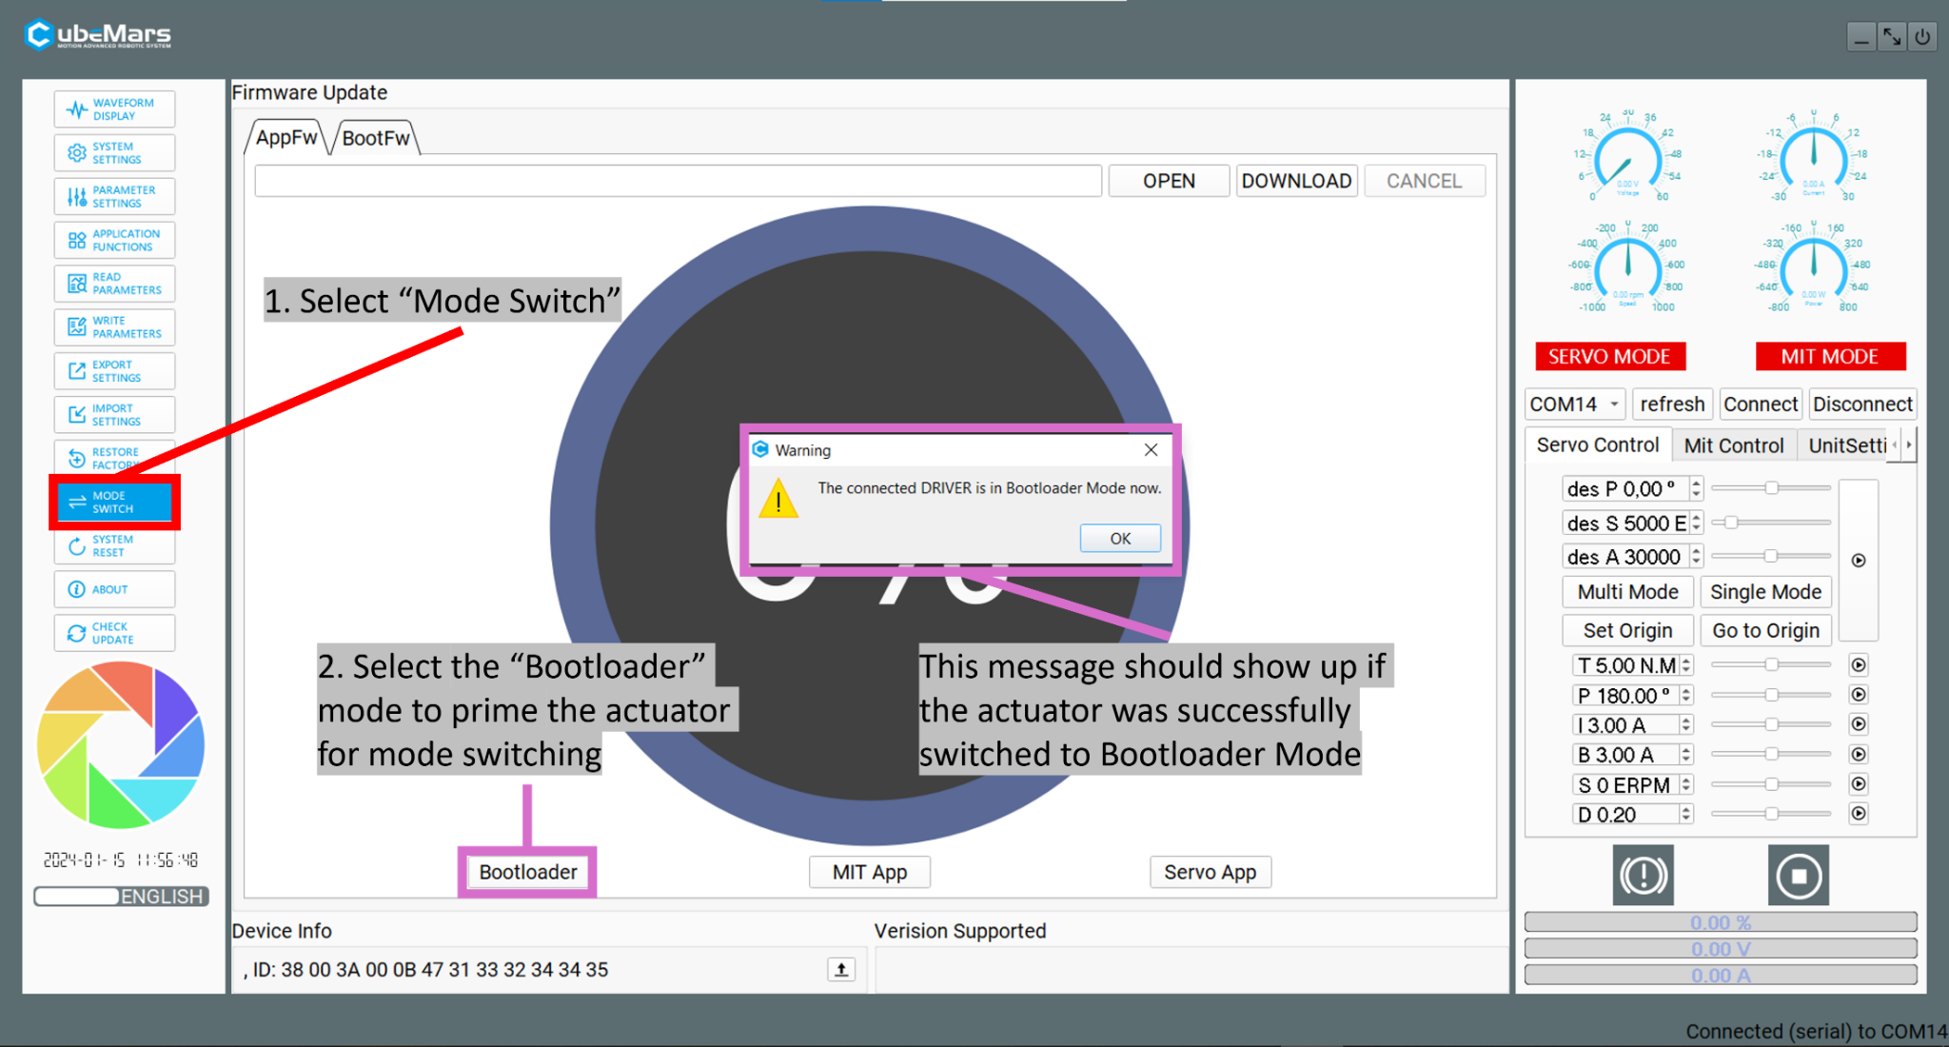

Slide 11
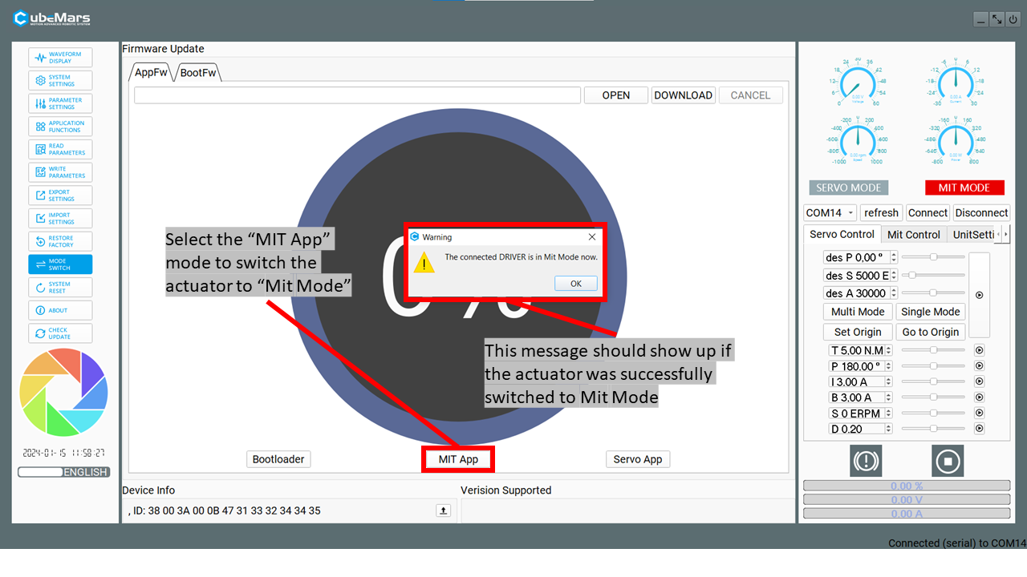

Slide 12
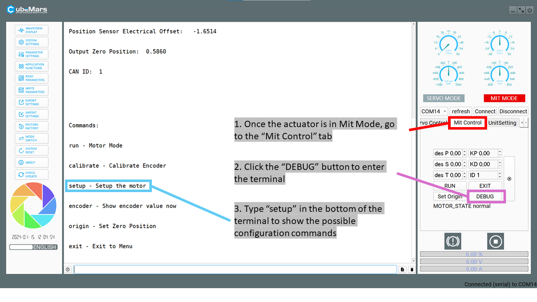

Slide 13
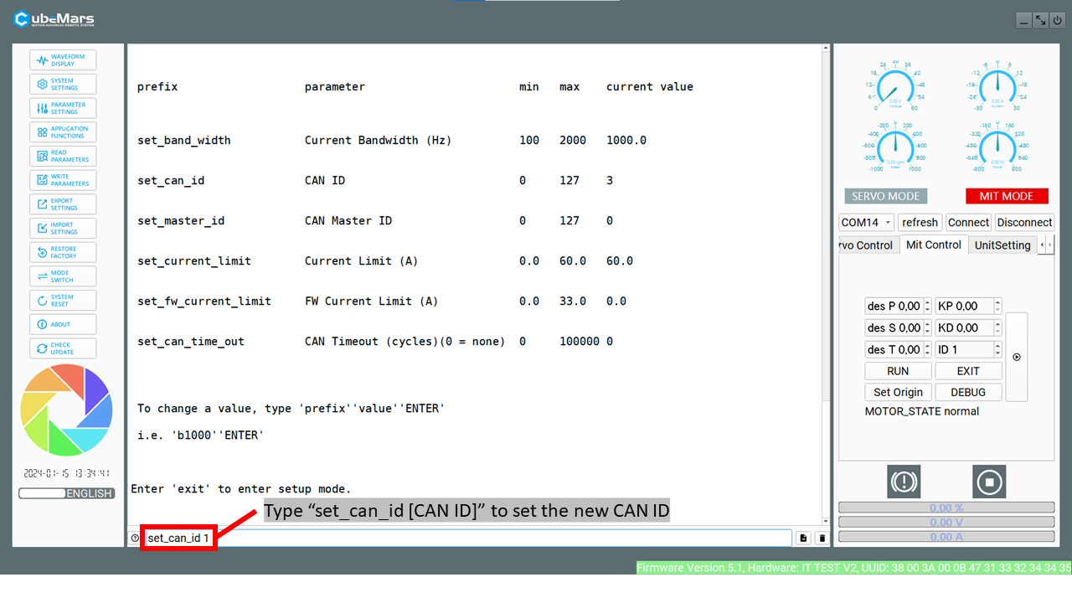

Slide 14
